Slide 1
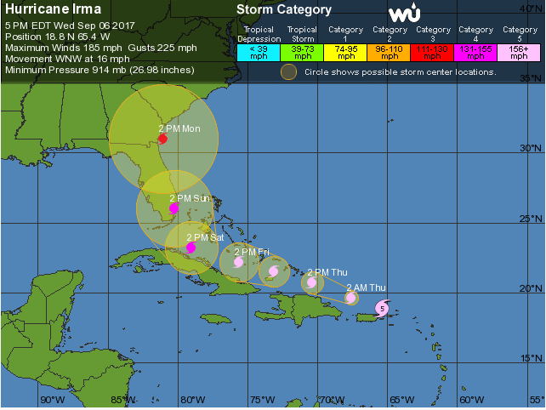
Recovery Program Management

Slide 2
Questions?
Text any questions during the presentation to Chris Lafleur at:
337-356-9433

Slide 3
Industrial Safety Solutions
Premier provider of HSE expertise and personnel to O&G industry since 1993
Focus on the people and the end in mind
Support Team:
Paul Perron
Terry Majors
Jonas Johnnie
Jim Simon
Chris Lafleur

Slide 4
SynergyNDS
The Recovery Program Manager for FMIT and now ad-hoc for TML
Provides response & recovery services to FMIT’s 385 public entities
Bottom line responsibility to:
Expedite repairs
Minimize disruption to daily ops
Provide cost effective solutions during life-cycle of the claim

Slide 5
Recovery Program Management
Cradle-to-grave or blended approach
Managed Vendor Program (MVP)
Deploy and manage necessary resources responsibly to perform:
Damage assessment
Critical path analysis
Overall recovery management services

Slide 6
Trackdown
SynergyNDS’ software
Complete recovery management tool
Initial assessment & project management
App store or Google Play store: Trackdown – government edition
Test login information:
Username: test
Password: test

Slide 7
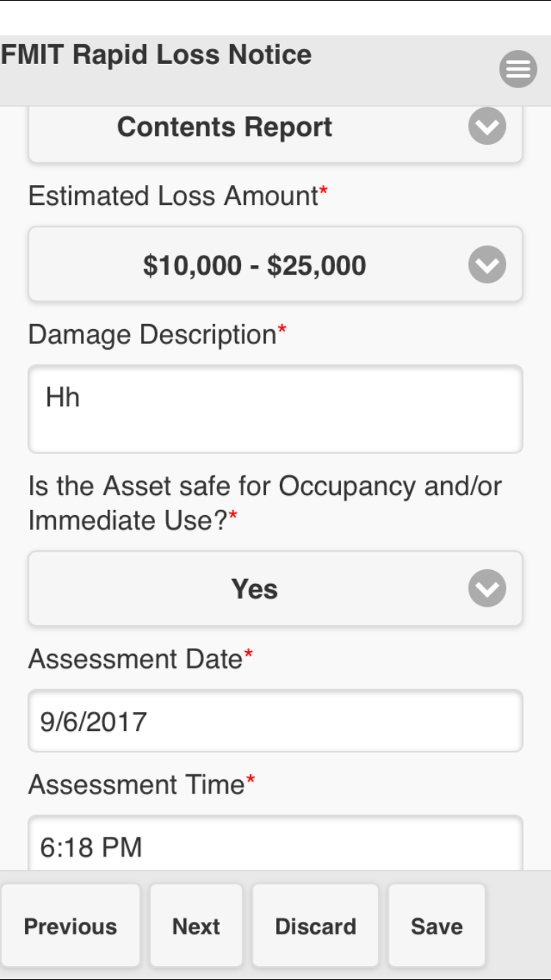
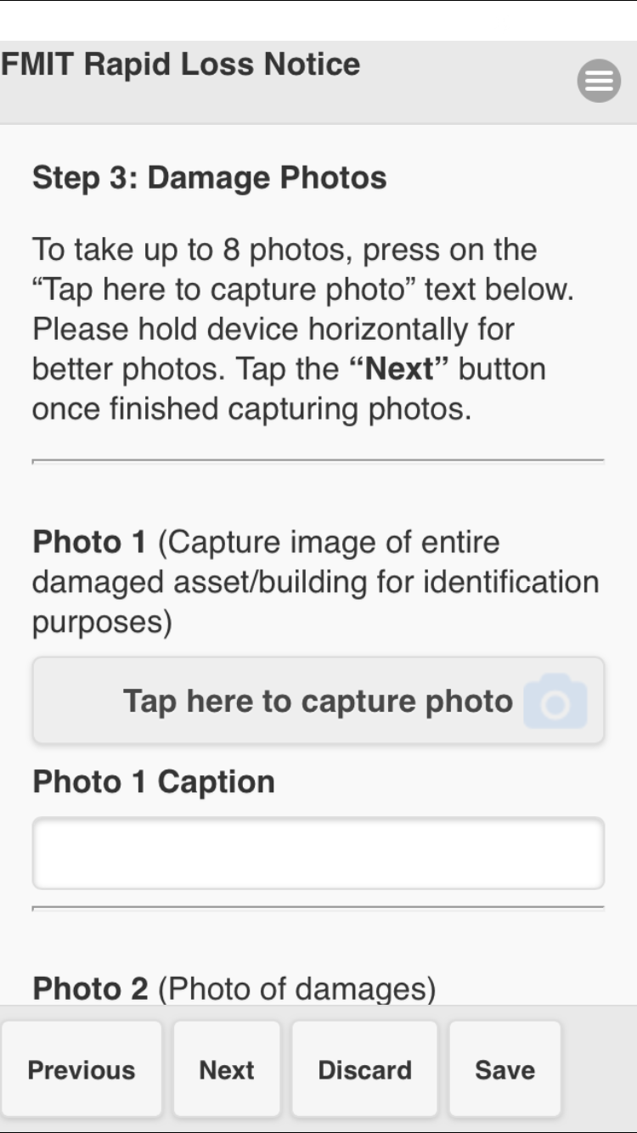
Trackdown
Rapid Loss Notices Purpose:
Provide a very general view of damaged assets
Estimate of the cost of damages
Clear photos of the damages
Fill out form to best of your ability
Provide as much general and specific detail
Goal is to assist Trust staff with quantifying the damages

Slide 8
Trackdown
Tracking platform to:
Document activities
Validate project related costs
Facilitate informed real-time decisions

Slide 9
Recovery Project Management

Slide 10
Safety Role
General HSE oversight
This is not an oil & gas operation
Coaching role
Key activities
Conduct safety meeting when possible/appropriate
Hazard Identification
Raise awareness

Slide 11
Pre-Deployment
Arrive in Melbourne, FL on Friday 8Sep17
Use good journey management
Provisioned and Credentialed at SynergyNDS’ office
1301 W. Eau Gallie Blvd #96, Melbourne FL 32935
Assigned AOR and receive further instructions

Slide 12
Packing Requirements and Recommendations
PPE Required:
Hardhat
Steel toed boots
Eye protection
Gloves
High-Vis Vest (if available)
Attire
Relatively professionally dressed
Cargo/khaki type pants & polo style shirt for first couple of days
Jeans are okay after work is underway
Enough clothes to last several days
Food for 2-3 days
Ice chest
Plenty of bottled water (2-3 cases)
Sleeping bag
Mosquito repellant
Baby wipes, powder
Towels
Personal hygiene items to include shower shoes
At least 2 weeks of any medications

Slide 13
Communications
Timesheets sent in every Sunday
Track mileage daily and include on timesheet
Daily check in via text to your FOS
Call your FOS with any questions or concerns
Technical/software issues contact Paul Perron

Slide 14
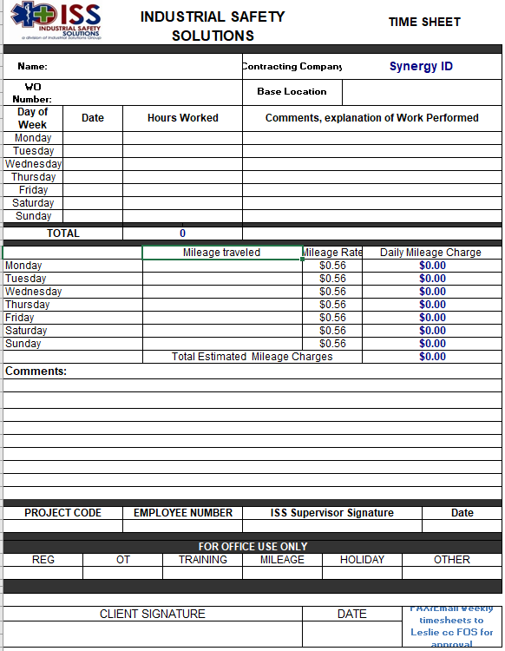
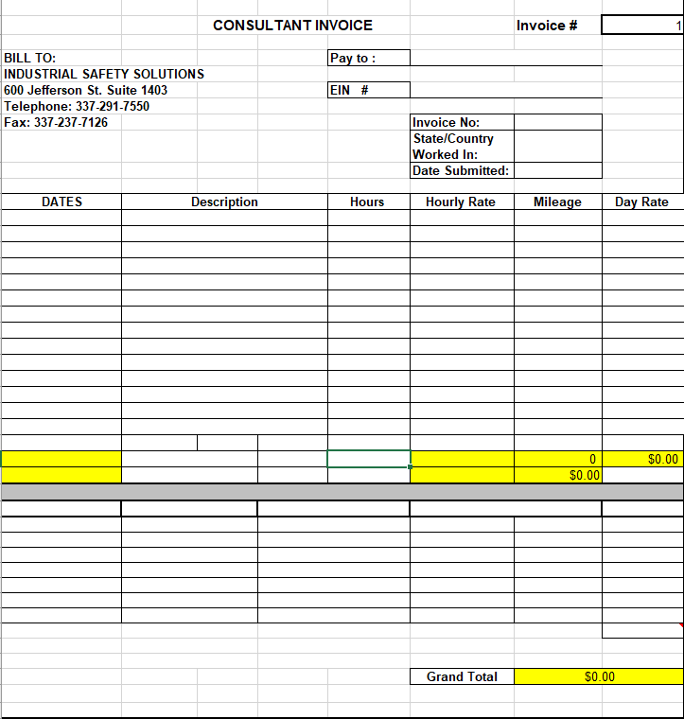
Timesheet

Slide 15
Contact Information
Paul Perron – 337-344-0879; pperron@indsg.com
Terry Majors – 337-852-5207; tmajors@indsg.com
Jonas Johnnie – 504-261-8091; jjohnnie@indsg.com
Jim Simon – 908-783-0156; jsimon@indsg.com
Chris Lafleur – 337-356-9433
clafleur@indsg.com

